Slide 1
Electronics Workshop
C Programming (1)
Installation and IDE Setup

Slide 2
Visual Studio
Good since…
Does compile for you
Organizes files for you
But…
Only one main file is allowed
Meaning to create an executable solution, a new project file must be created to create another executable.

Slide 3
Microsoft Visual Studio Community
Has default C++ compiler
We can still compile and run C
Go to https://www.visualstudio.com/
Click on “Download Visual Studio”
Select Community version
Or simply go to https://www.visualstudio.com/thank-you-downloading-visual-studio/?sku=Community&rel=15#

Slide 4
After Installation…
To create a C program…
Go to File -> New -> Project
New window pops up, select…
Templates -> Visual C++ -> Store Apps -> Win32
Select Win32 Console Application

Slide 5
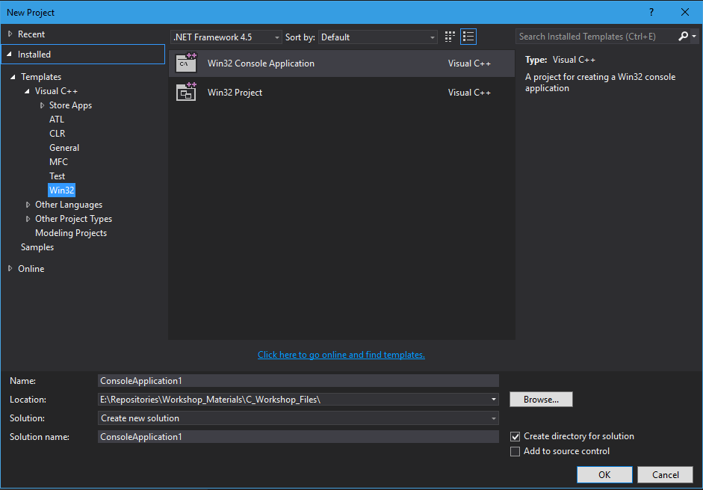

Slide 6
Set location and project name
Click OK, and new project will be created.
Under solutions, 4 folders are created
External Dependencies
Header Files
Resource Files
Source Files
Right click on Source Files,
Add -> New Item…
Click on C++ File, and name the extension as .c, instead of .cpp!

Slide 7
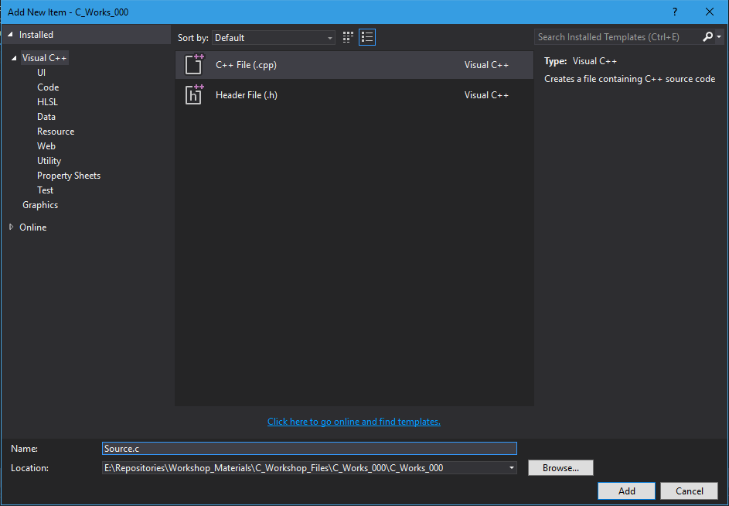
Change extension to .c!

Slide 8
To Compile & Run
In Source.c
int main(void) { return 0; }
Then save
On menu
Click Build -> Build Solution
Once build is completed, build window will show up
Click Debug -> Start Debugging
A console window will popup and quickly disappear

Slide 9
For further use…
To open examples, simply open .sln file

